Slide 1
«Gender and corruption»
Prague
23 February, 2016
Gro Skaaren-Fystro
Transparency International Norway
www.transparency.no
Notes:
1

Slide 2
Gender, equality and corruption:
What are the linkages?
Gender inequalities undermine good governance, sustainable growth, development outcomes and poverty alleviation. Where countries have made advances in women’s empowerment and gender equality, they have witnessed lower levels of corruption over time.
(Source: TI Policy Brief 01/2014)

Slide 3
Are women less corrupt?
Womens tolerance of corruption
Womens perceptions of corruption
Womens experiences of corruption
There is no consensus on the exact interplay between gender, inequality and corruption. Therefore, if women are increasingly confronted with corruption as they enter into the work force, take up more senior management positions and achieve greater equality, there is no evidence to suggest that women will not participate in corruption.
(Source: TI Policy Brief 01/2014)

Slide 4
Summary on research on gender differences in corrupt behaviour
Attitude towards corruption:
  Survey responses suggest a lower tolerance of women towards corrupt behaviours
  However it seems that this is true only in democracies, but not in autocracies and environments where corruption is endemic and widely tolerated
  (Source:U4 Brief 2015 no. 7)

Slide 5
Survey summary cont…
Accepting bribes
  With some exceptions that seem to respond to contextual factors, there is no significant difference between men and women.
  Women behave more opportunistically: they may accept the bribe, but don’t reciprocate with a corrupt favour
  Women are less likely to accept bribes than men when there is a preceived risk of sanctions
  (Source:U4 Brief 2015 no. 7)

Slide 6
Survey summary cont…
Offering bribes
  Men are more likely to offer bribes
  The value of bribes offered by men tends to be highter
  Both men and women offer highter bribes to men than to women
                (Source:U4 Brief 2015 no. 7)

Slide 7
The impact of corruption on women
Gender specific corruption
Household resources
Public services
Public life and decision-making
Womens rights
Reporting and redress mechanisms
(Source: TI Policy Brief 01/2014)

Slide 8
Policy recommendations
Address forms of corruption that affect women most
Involve women in anti-corruption strategies
Train and support women as leaders in their countries and regions
Ensure women actively participate in public life
Integrate women into the public service work force.
Implement gender-responsive and participatory budgeting
Guarantee gender sensitive reporting mechanisms
Capture the gender dimension of corruption in data collection (Source: TI Policy Brief 01/2014)

Slide 9
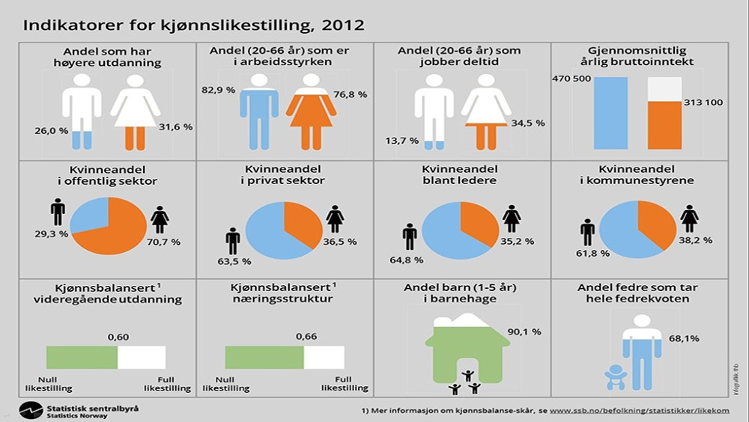

Slide 10
Norwegian Challenge
«To what extent do you believe that various forms of corruption such as bribery, favoritism of family and friends, occurs in the Norwegian public sector?» (Per cent)
 | State |  |  |  | Local government
 | Men | Women | Men | Women | Men | Women | Men | Women
Very little extent -3 | 6 | 4 | 25 | 21 | 4 | 4 | 22 | 19
-2 | 10 | 8
 |  |  |  |  | 8 | 7
-1 | 9 | 9 |  |  | 9 | 8
0 | 14 | 13 |  |  | 13 | 11
1 | 21 | 22 | 42 | 40 | 20 | 21 | 48 | 45
2 | 13 | 13 |  |  | 18 | 16
Very large extent +3 | 8 | 6 |  |  | 10 | 8
Do not know/no opinion | 19 | 26 |  |  | 17 | 25
SUM | 100 | 100 |  |  | 100 | 100
Source: Difi 2015

Slide 11
Perceived corruption
«To what extent do you believe that various forms of corruption such as bribery, favoritism of family and friends, occurs in the Norwegian public sector?»
(Responses transformed to continual scale 0-100, 100=max level of perceived corruption. No opinion and neutral excluded)

Slide 12
Trust
To what extent are you confident that local politicians work for the benefit of the citizens? (Per cent)
 | Men | Women | Men | Women
Very little extent -3 | 8 | 6 | 28 | 24
-2 | 9 | 7
-1 | 12 | 11
0 | 15 | 13
+1 | 22 | 25 | 45 | 49
+2 | 17 | 19
Very large extent +3 | 6 | 5
Do not know/No opinion | 12 | 14
SUMMARY | 100 | 100
Source: Difi 2015

Slide 13
Trust
To what extent are you confident that politicians work for the benefit of the citizens?
(Responses transformed to continual scale 0-100, 100=max level of trust. No opinion and neutral excluded)

Slide 14
Thank you
www.transparency.no

