Slide 1
ARACHNE
Risk scoring tool
Fraud Risk Assessment and
Management for ESI Funds
2014 - 2020
Prague 03/11/ 2016
Luc Molemans – DG EMPL - IT project manager

Slide 2
Agenda
What is Arachne ?
  Aims and Objectives
  Benefits
State of play
Overview of Risk Categories
Data flow
Arachne tool : some screenshots

Slide 3
Objectives
Provide the MA's with a tool which can help them to comply to Article 125 (4)(c) of the Commission Regulation (EU) No 1303/2013:
  "managing authorities have to "put in place effective and proportionate anti-fraud measures taking into account the risks identified"

Slide 4
Project ARACHNE aims at providing the MS authorities involved in management of the Structual Funds with an operational tool to identify
1. their most risky projects and contracts
2. potential risks linked to all their projects

Slide 5
Support the Management and Control Systems of the OPs, to reduce the error rate and strengthen
fraud prevention and detection
Facilitate the continuous monitoring / overview of the internal and external data regarding projects, beneficiaries and contracts/contractors

Slide 6
How ?
-> Based on a set of risk indicators and alerts
-> Using some key (internal) data of projects, contracts and expenses, enriched with publicly available information (external data)

Slide 7
Benefits
Promote the use of a risk based approach in the verifications of the projects (focus on most risky projects)
Complement the risk current assessment with regard to fraud alerts and irregularities
Identify possible irregular circumstances continuously on the basis of predefined risk criteria
Build an overall better defense against fraud and errors

Slide 8
ARACHNE – Status in Member States
    22 are currently involved into Arachne:
    16 testing/using Arachne
      IT,PT,CZ,RO,HR,PL,BE,
      BG,HU,ES,FR,SK,NL,EE,UK,MT (*)
    6 are creating/finalising their files
      CY,SI,AT,LT,LV,LU
    * at least 1 program
    4 In 'reflexion' phase
      SE,IE,DK,FI
    2 Not using Arachne DE,GR
²

Slide 9
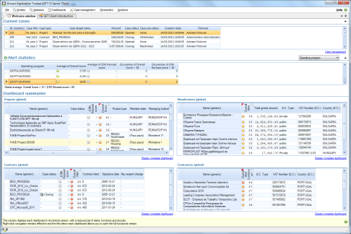
Data Flow
Member States
DIGIT
GET Application Server
Operational Data
Operational Data
GET database
Vadis
European Commission
Member States
Operational Data
GET database
Orbis
World Compliance

Slide 10

Orbis
  Orbis has information on :
    Companies : +/- 201 million companies worldwide
      Financial data of the company (turnover, shareholders, …)
      Address information
      Related people (directors, contact people, …)
      Indicators like credibility and bankruptcy
    Persons : +/- 113 million persons
      First name, last name, Age
      Number of affinities, number of companies and role in company
  The data is collected from publicly available information such as official annual reports or balance sheets submitted to regulatory bodies
  The level of details available in the database varies by country and company size
  All data available in Arachne

Slide 11

World Compliance
  World Compliance collects, aggregates and centralizes :
    PEP lists (politically exposed person)
    Sanctions lists (EU Terrorism List, ICE List, CBI List, …)
    Enforcement list (narcotic & human traffickers, money launderers, fraudsters and other criminals, …)
    Adverse media list (company or person that have been linked to illicit activities by news sources)
  The data is received from regulatory and governmental authorities (except for adverse media list)
  Information is only accessible through the Arachne alert details (It won’t be possible for a user to explicitly retrieve these information for a given company/person)

Slide 12
Risk category | Description
Procurement | Risk indicators on the procurement process
Contract management | Assessment of contract management aspects of the project and comparison to the peer group
Eligibility | Verification of the eligibility period and existence of contractors and subcontractors
Performance | Assessment of the coherence of activity sector ratios with the benchmark values
Concentration | Cross-project and cross-operational program checks
Reasonability | Basic checks on logicality and reasonability of project data
Reputational and fraud alerts
 | Financial: Overall financial performance of beneficiaries, contractors / suppliers and sub-contractors, based on financial reporting data
 | Relationship: Existence of relationships between beneficiaries and contractors / suppliers or sub-contractors and their respective personnel
 | Reputation: Involvement in activities (such as bankruptcies) that could possibly result in reputational damages
 | Sanction: Identification of beneficiaries, contractors/suppliers, subcontractors or their respective personnel, blacklisted of appearing in any type of sanction list
 | Change: Any type of changes to the company structure

Slide 13

Arachne risk scoring tool
Screenshots

Slide 14
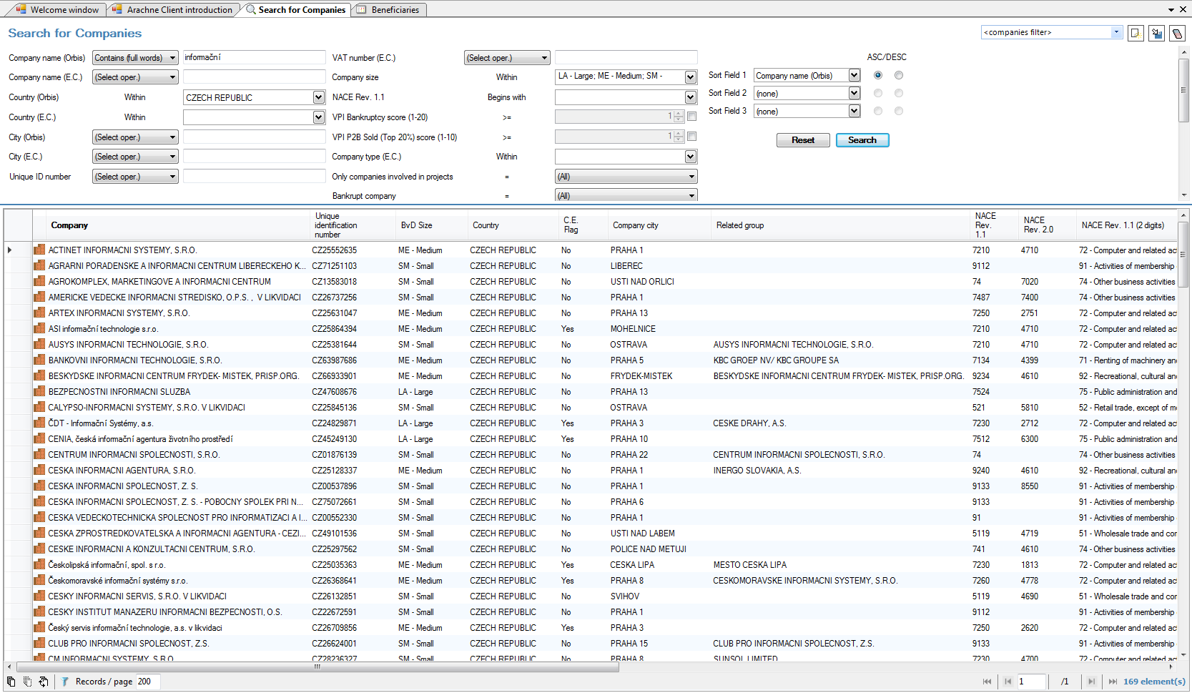
Company information

Slide 15
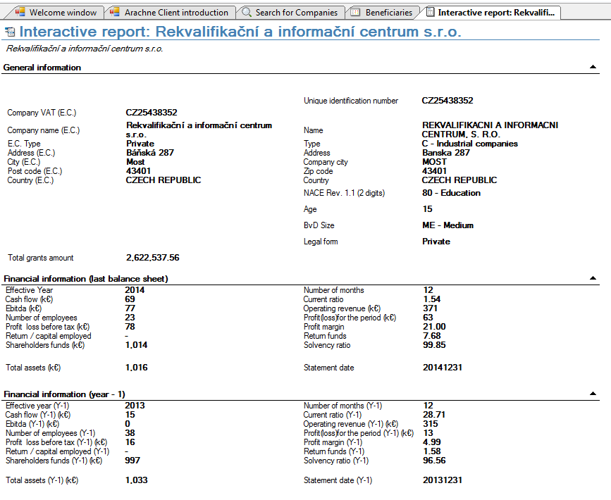
Interactive report

Slide 16
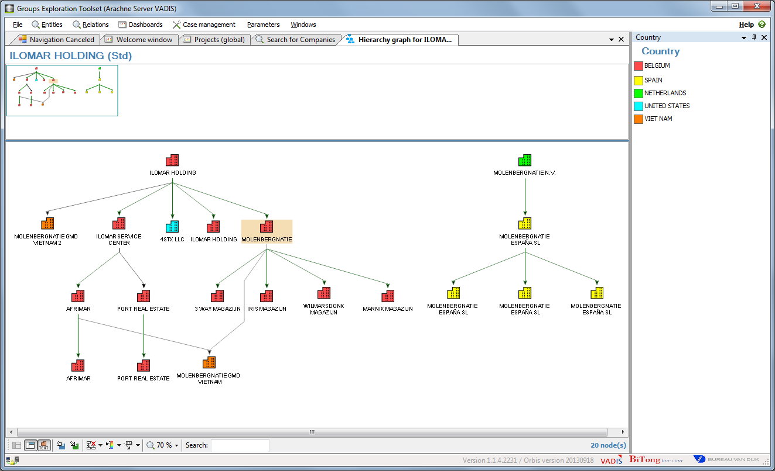
Hierarchy graph

Slide 17
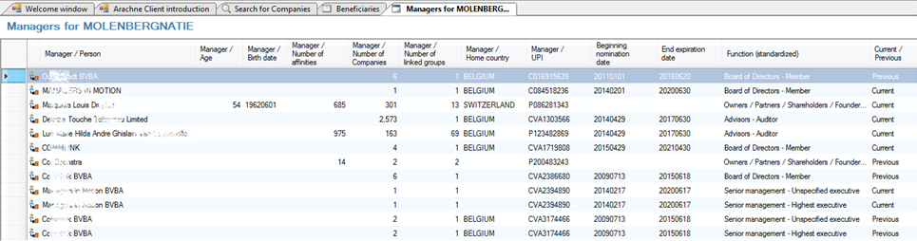
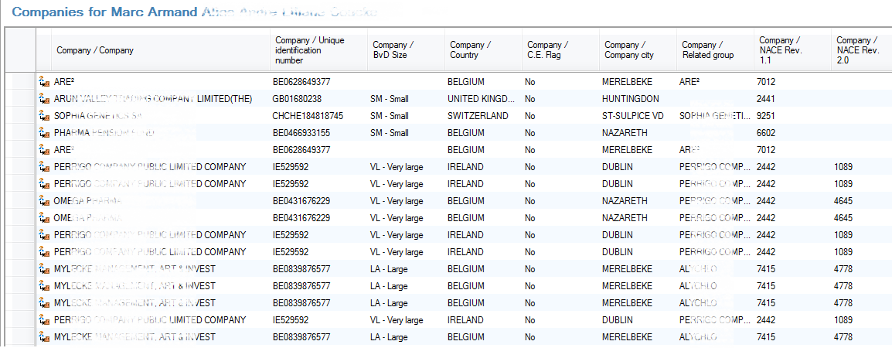
Managers information

Slide 18
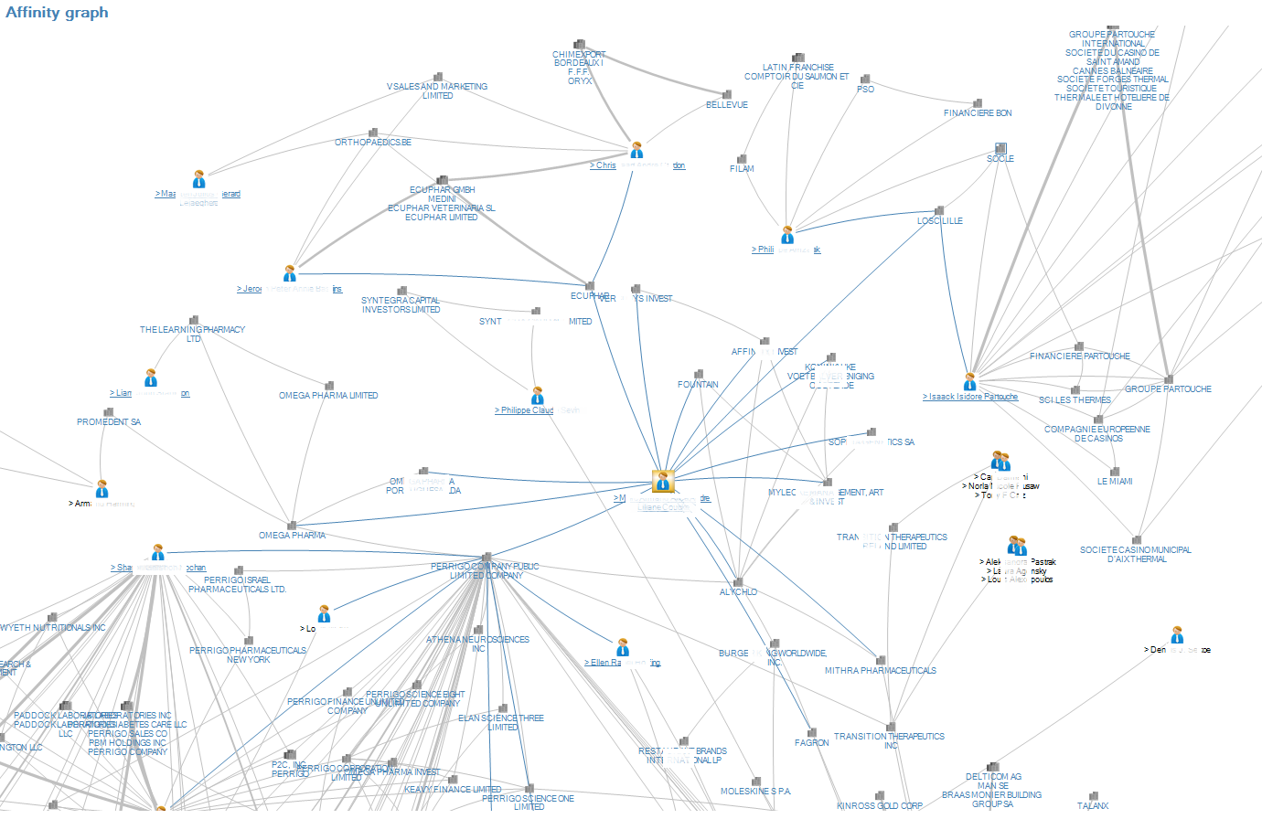
Affinity Graph

Slide 19
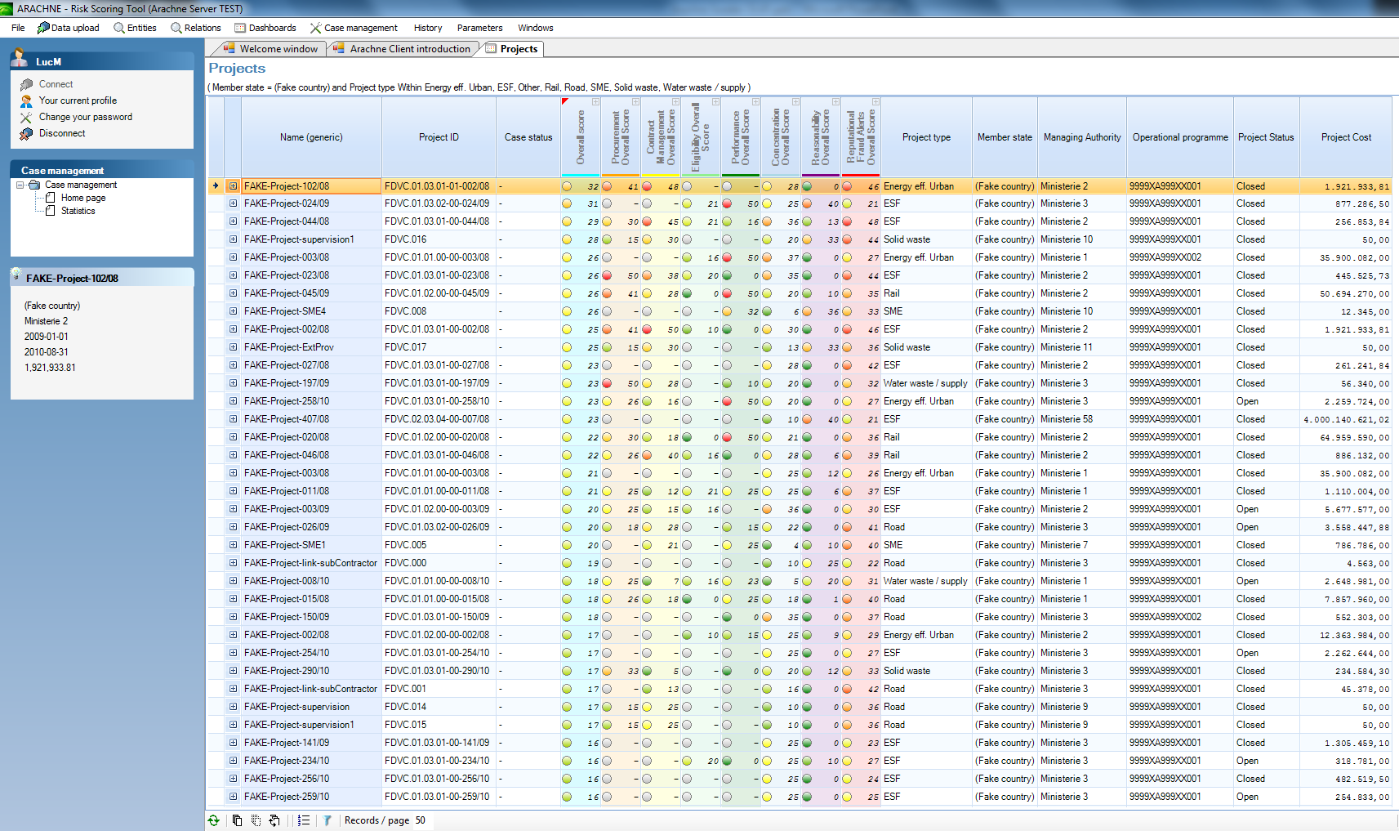
Project Dashboard

Slide 20
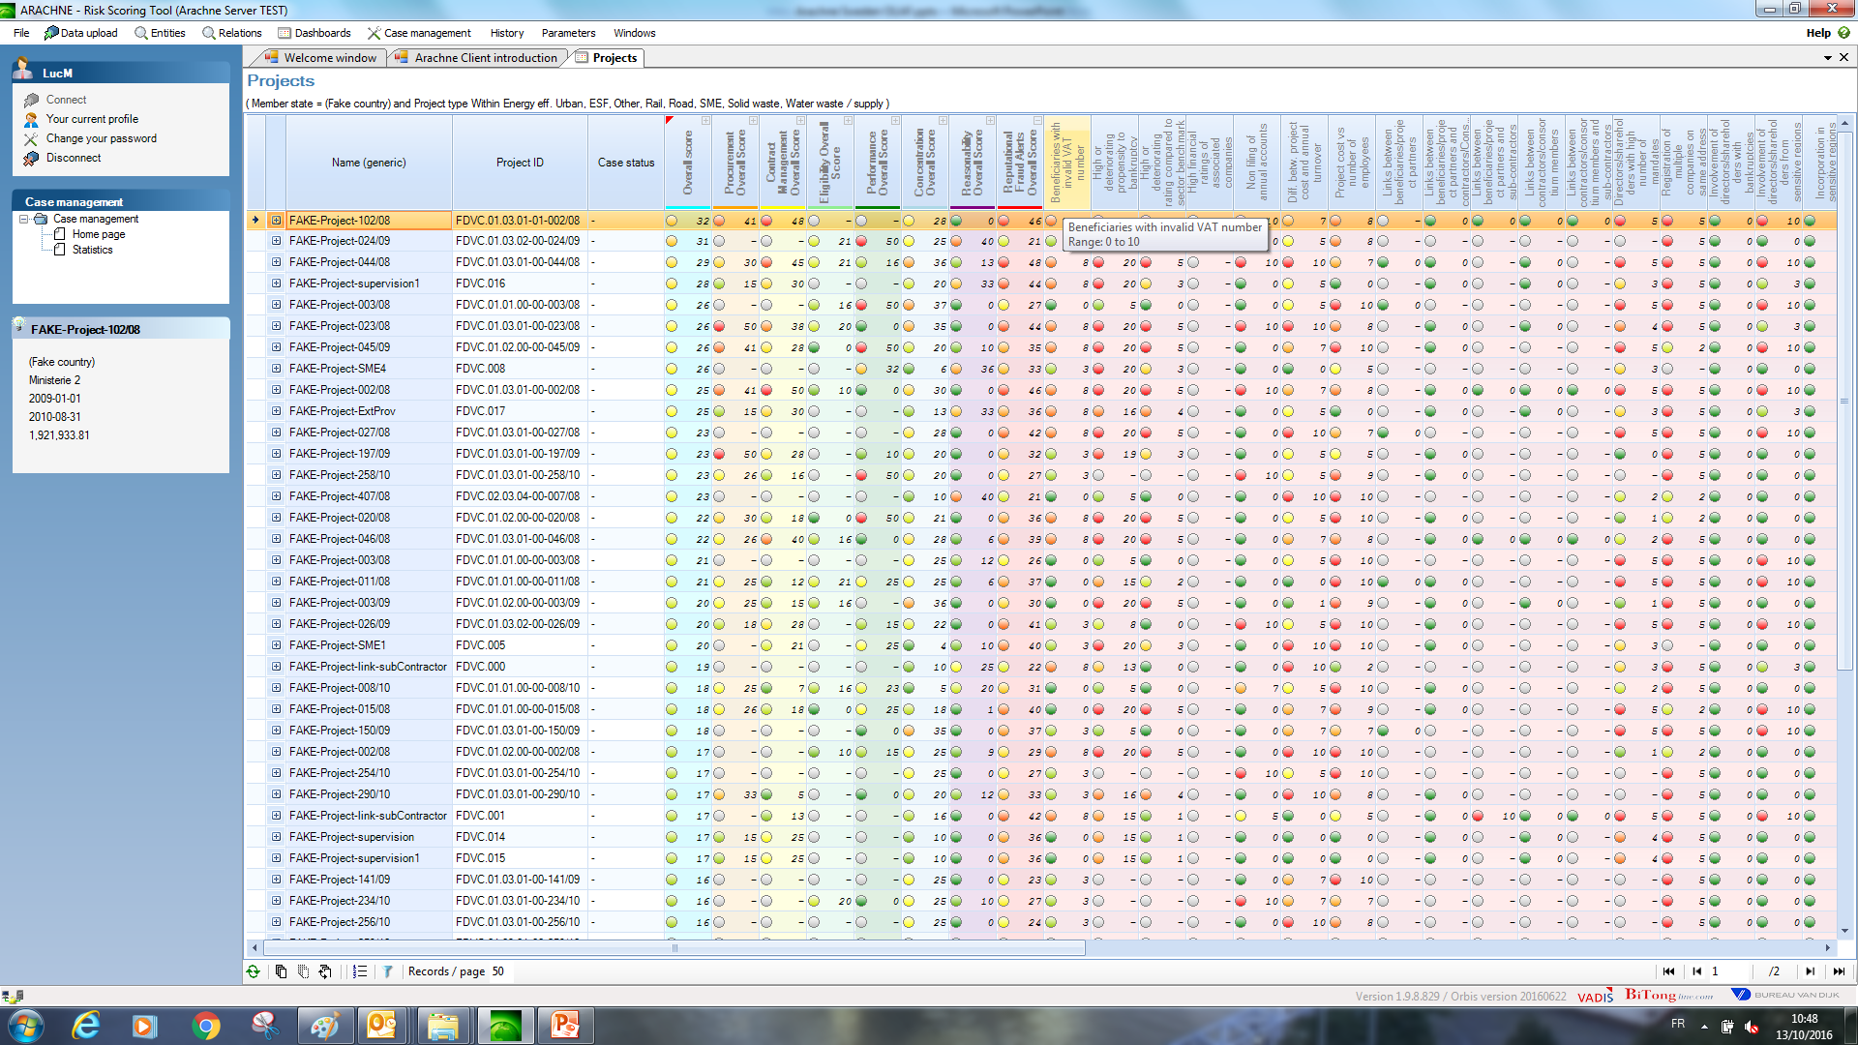
Project Dashboard

Slide 21
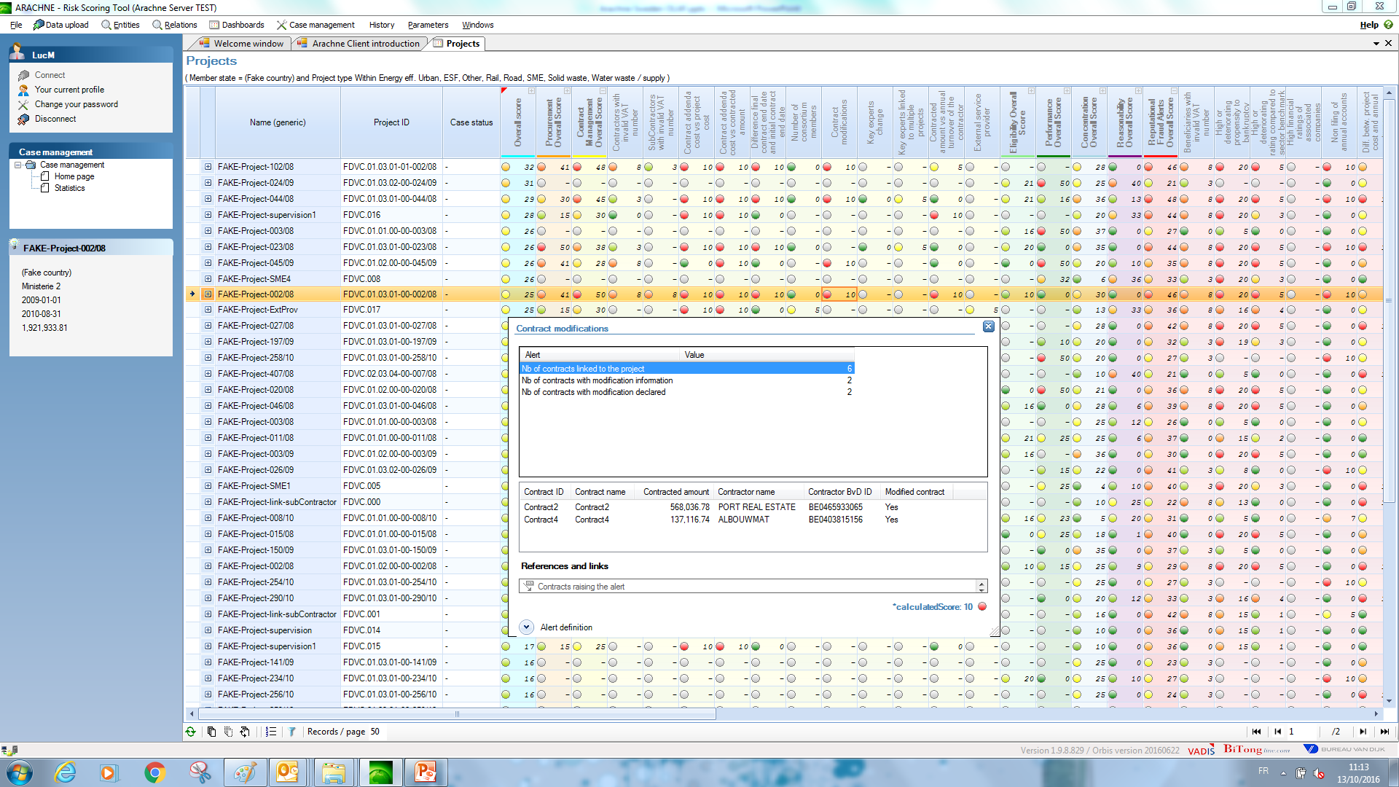
Project Dashboard

Slide 22
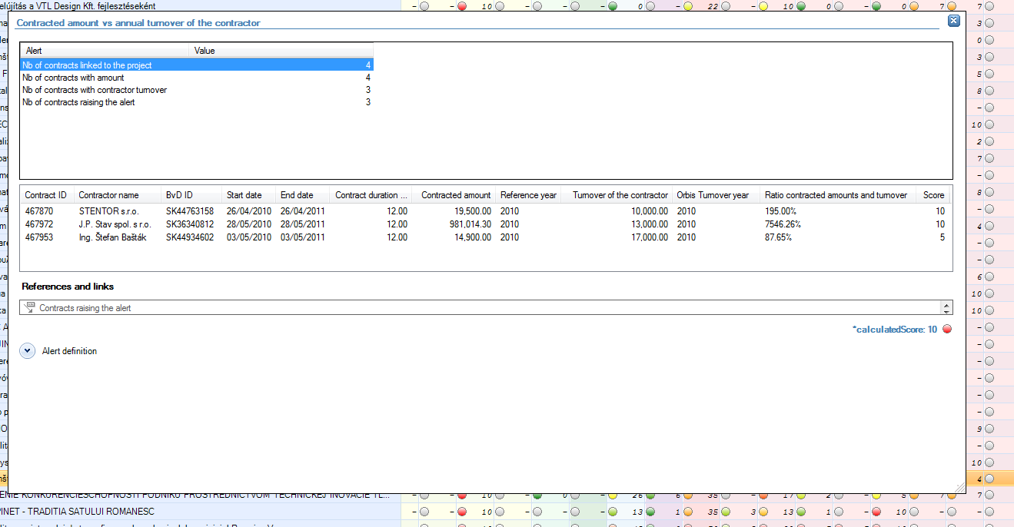
Project Dashboard
Contract amount versus annual turnover

Slide 23
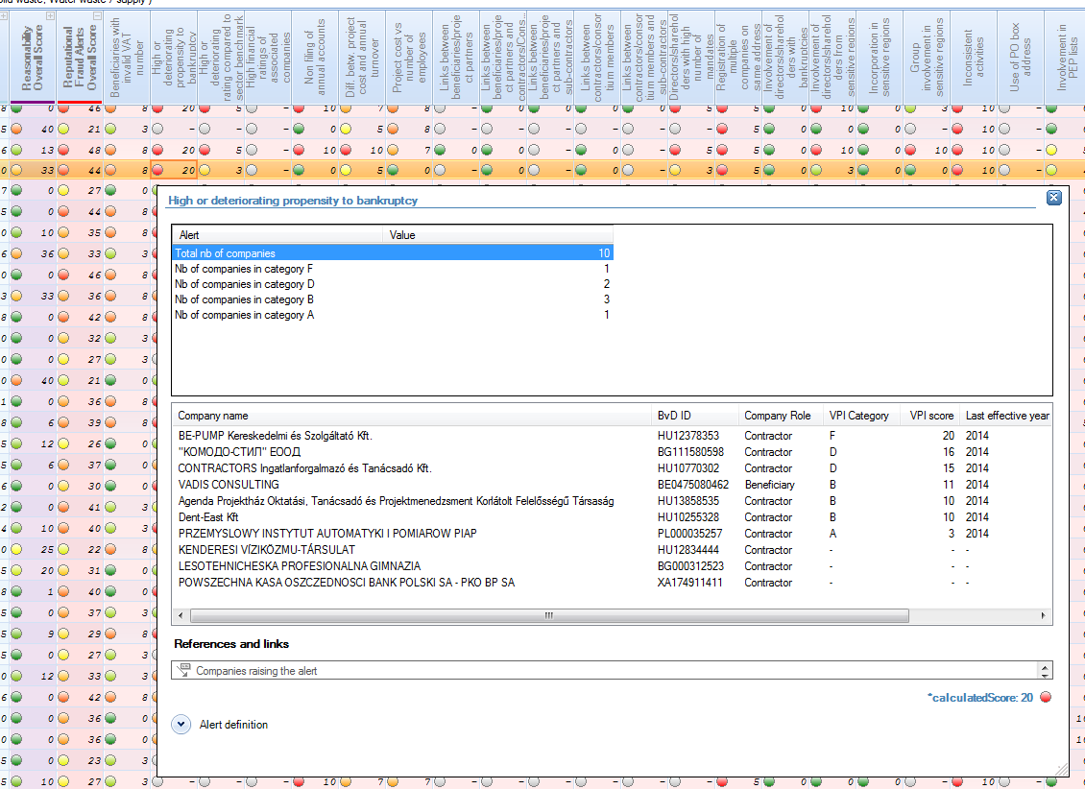
Project Dashboard
Propensity of bankruptcy

Slide 24
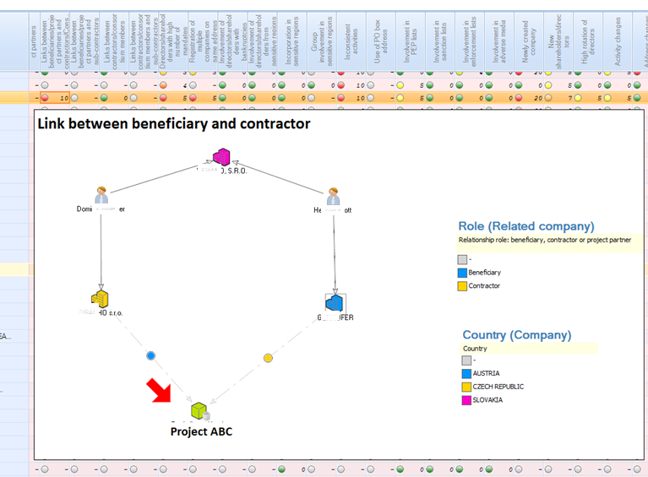
Project Dashboard
Link between beneficiary and contractor

Slide 25
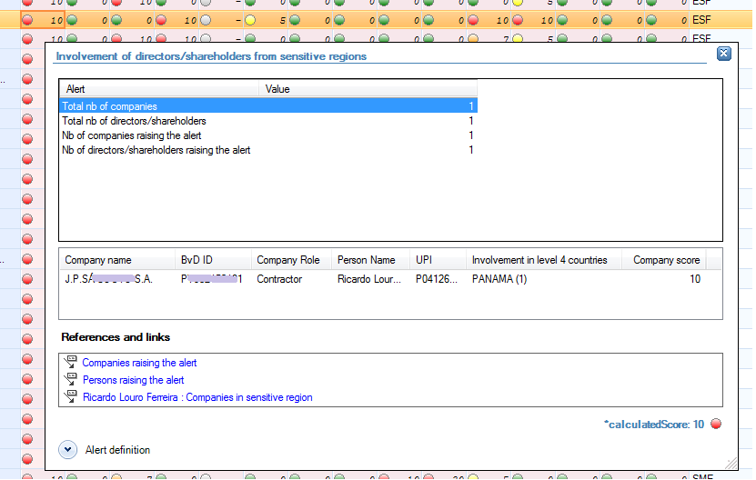
Project Dashboard
Involvement in sensitive regions

Slide 26
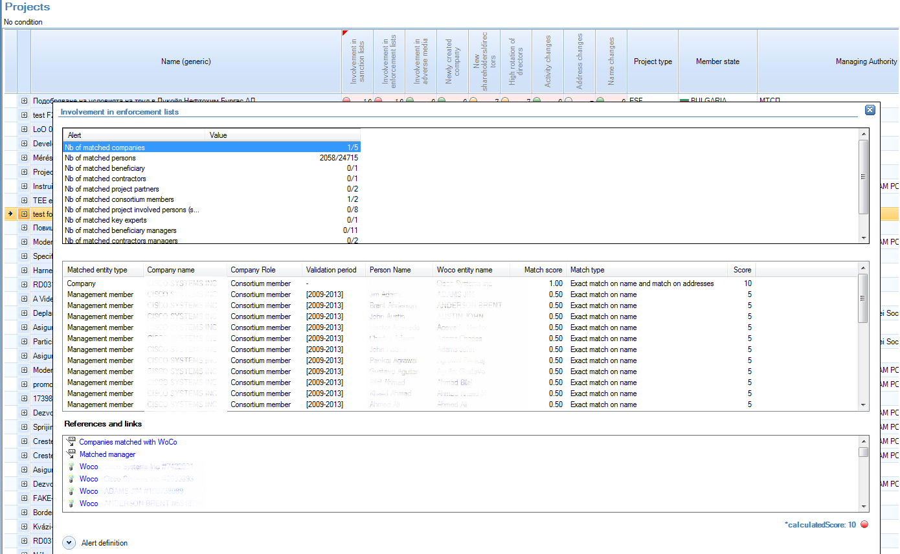
Project Dashboard
Involvement in Enforcement lists

Slide 27
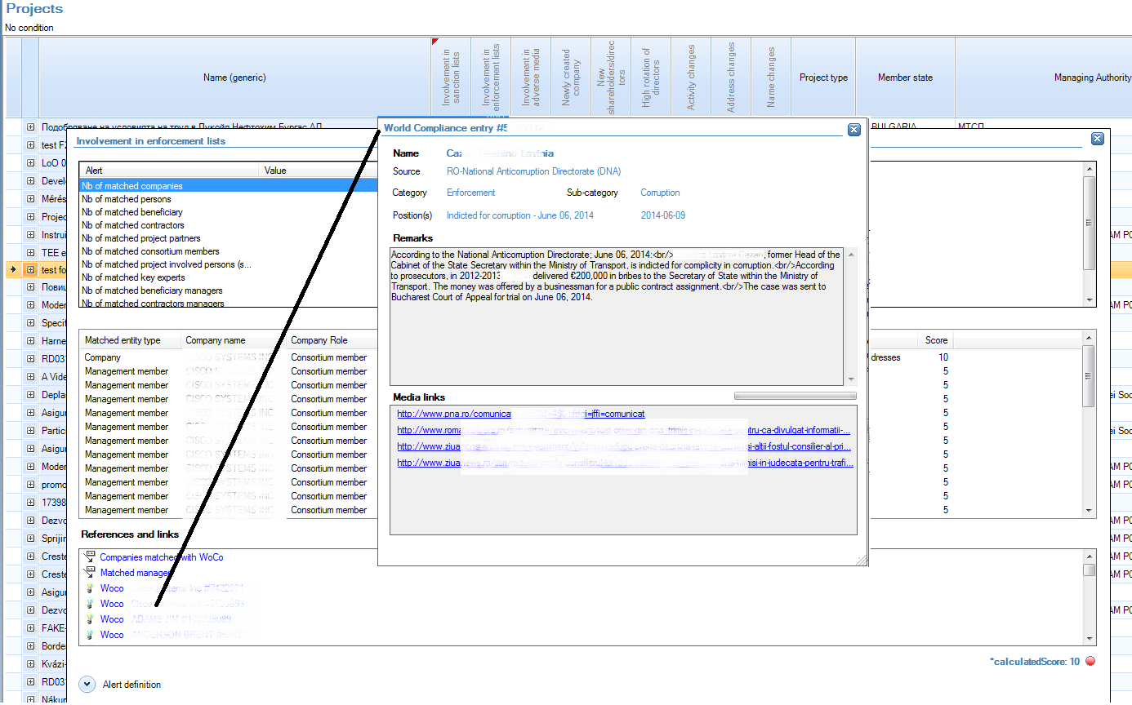
Project Dashboard
Involvement in Enforcement lists

Slide 28
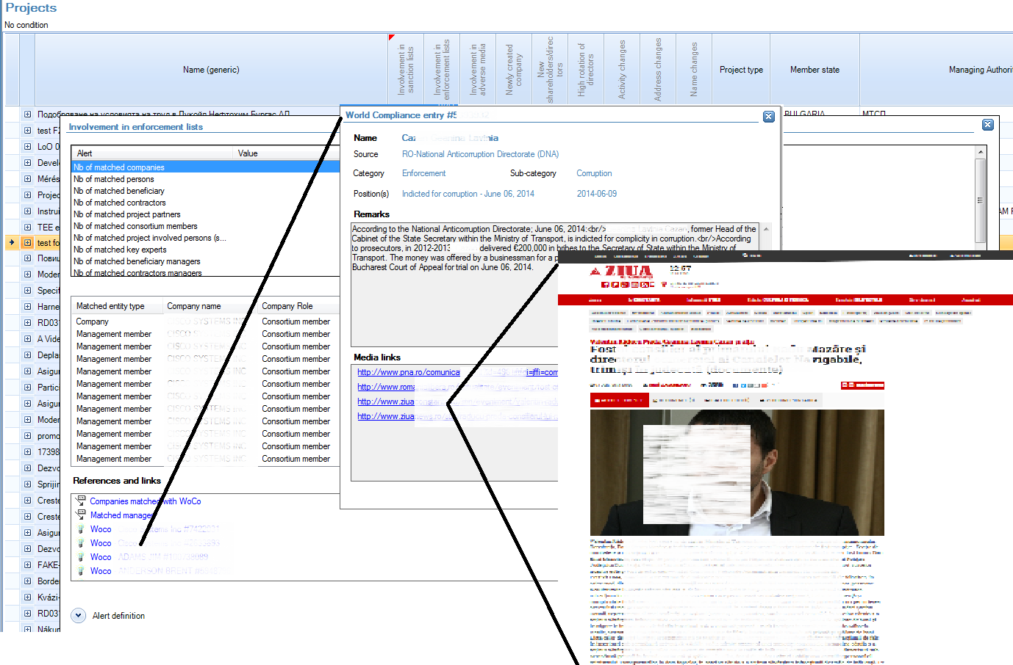
Project Dashboard
Involvement in Enforcement lists

Slide 29
Project Dashboard
Involvement in Enforcement lists

Slide 30
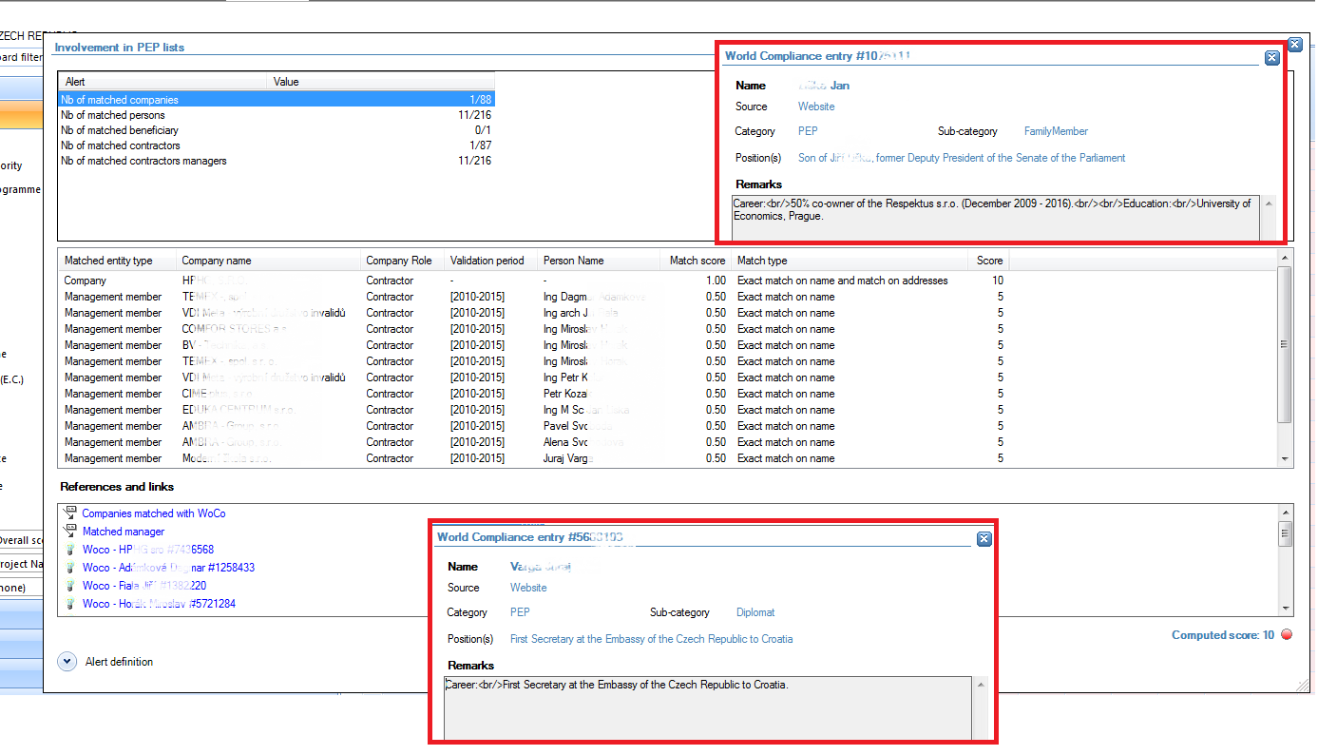
Project Dashboard
Involvement in PEP lists

Slide 31
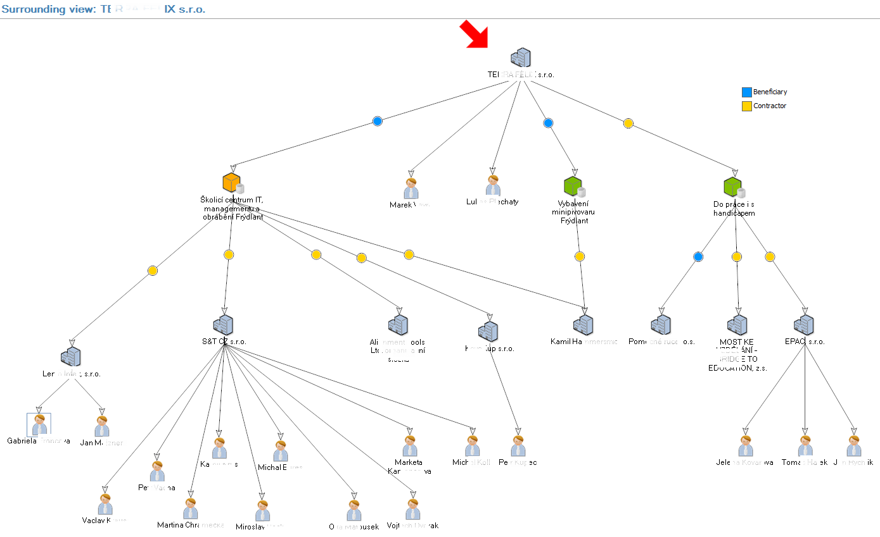
Surrounding view

Slide 32
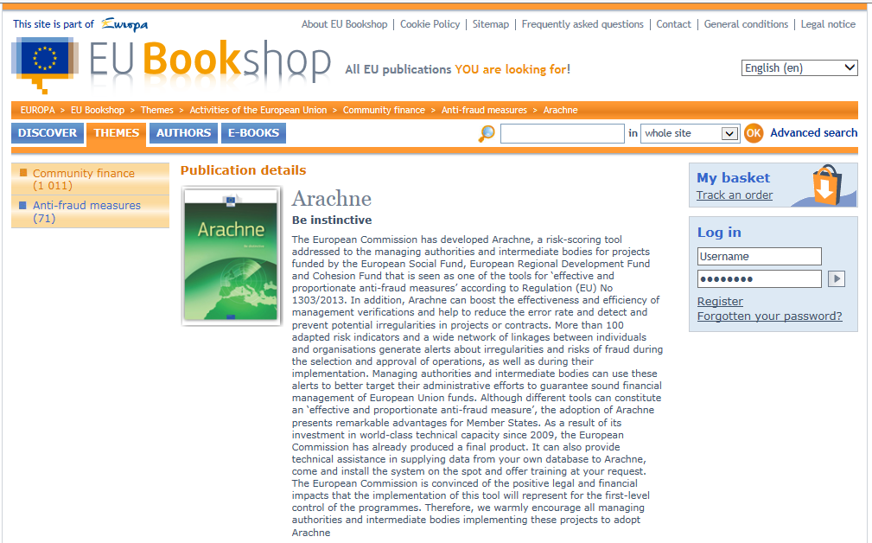
Arachne brochure

Slide 33
Thank you for your attention

