Slide 1
EU Funds – Fraud and Fraud Prevention Tools
The Hungarian Case
EU Funds: Fraud Risk Management
November 3, 2016 - Prague, Czech Republic

Slide 2
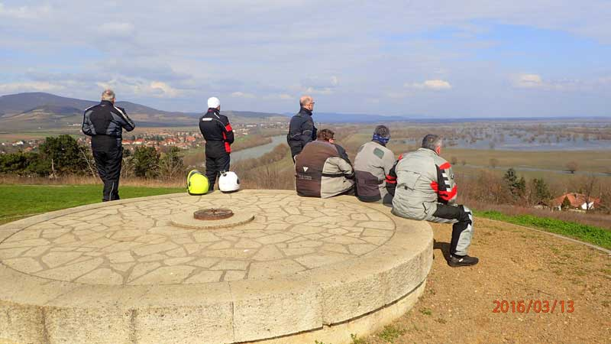

Slide 3
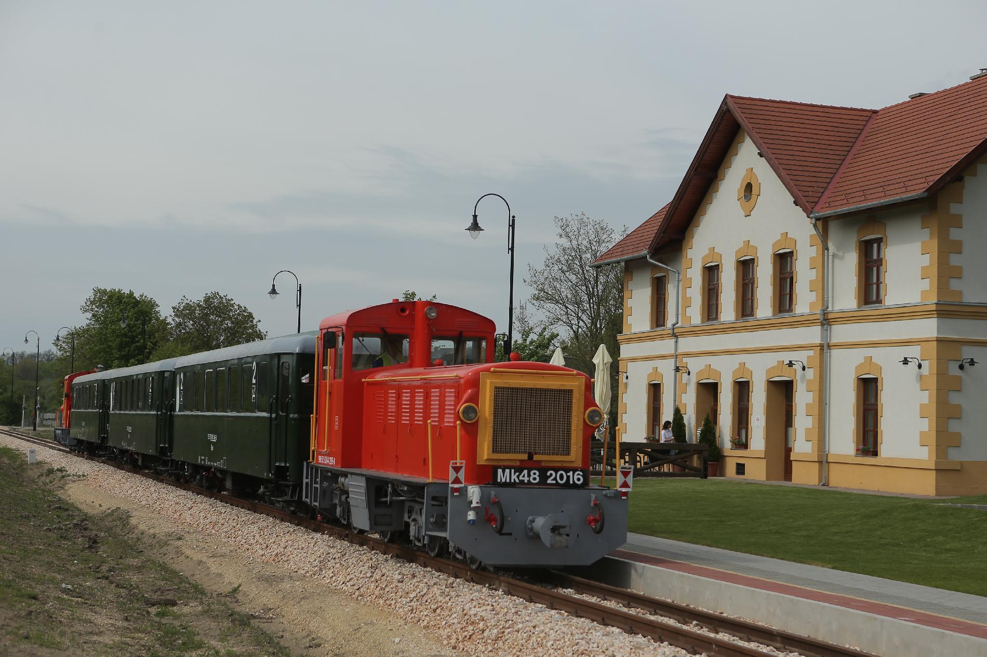

Slide 5
Corruption Risks of the Use of EU Funds in Hungary
in average 3.5 billion EUR/year allocated to Hungary;
abundance of funds & pressure on absorption
unjustified development goals and projects;
overplanning of projects financially;
overpricing
less inclined to effective control mechanisms;
the riskiest phase: public procurement

Slide 6
CSO tool: Integrity Pacts
legal tool developed by Transparency International in 1994;
trilateral agreement under civil law
contracting authorities;
bidders;
independent civil organisation as monitor
for the purpose of monitoring a public procurement procedure;
all phases from preparation to the execution of the contract;
regular reporting to the public;
IPs around the world;

Slide 7
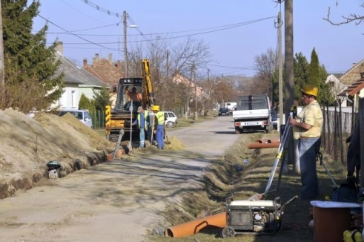
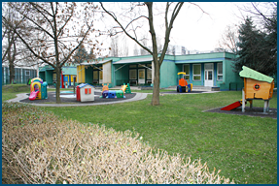
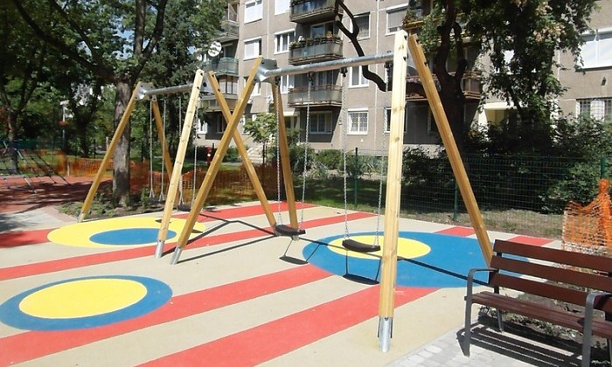
CSO tool: Integrity Pacts - TI Hungary’s Experiences -
2012/2013 – 2016. water supply infrastructure development in Ózd financed by the Swiss Confederation
2010-2012. procuring taxi services and PCs by Central Bank of Hungary
Implemented IPs until now
2015. playground development in the 13th District of Budapest
2013-2014. reconstruction of a nursery in the 13th District of Budapest
7

Slide 8
CSO tool: Integrity Pacts - Lessons from Hungarian experience with IP -
prices were lower by 30%;
increased trust from companies toward the public institutions;
increased competition;
authorities, State-owned companies: good PR value, PR possibility;
building trust and good cooperation with monitor, good experiences => usually more IPs later

Slide 9
EU Pilot Project: ‘Integrity Pacts – Civil Control Mechanism for Safeguarding EU Funds’
4-year pilot project supported by the European Commission (DG REGIO)
11 EU countries – 17 major public contracts;
together, these contracts are worth nearly €1 billion;
fostering collective actions:
we aim to work with the communities directly affected by each of the 17 projects. (For example, those who live near to where a power plant, highway, hospital or other facility is being built.)

Slide 10
IPs to be implemented within the framework of the European Commission’ pilot project

Slide 11
CSO tool: ‘Red Flags’ signalling tool www.redflags.eu
Objectives of the project:
To develop:
a new risk assessment methodology;
an interactive online monitoring tool;
a structured database available for controls, investigations and analyses.
Target groups:
authorities in charge of controlling public procurements;
private sector;
citizens.

Slide 12
CSO tool: ‘Red Flags’ signalling tool www.redflags.eu
About the tool:
Officially launched on 9 November 2015;
Based on TED database;
Monitors the Hungarian public procurement procedures above EU threshold;
Data since June 2012 ~16.000 procedures monitored;
Uses ca. 40 indicators;
Future plans;
Users;
Raising public awareness, Facebook campaign.

Slide 13
Thank you for your attention.
Gabriella Nagy
head of public funds programs
Transparency International Hungary
gabriella.nagy@transparency.hu
http://transparency.hu/

